Slide 1
Radial Basis Functions
We are going to consider a different approach, which is to use local neurons, where each neuron only responds to inputs in one particular part of the input space.
The argument is that if inputs are similar, then the responses to those inputs should also be similar, and so the same neuron should respond.
RECEPTIVE FIELDS
Notes:
we are going to consider a different approach, which is to use local
neurons, where each neuron only responds to inputs in one particular part of the input
space. The argument is that if inputs are similar, then the responses to those inputs should
also be similar, and so the same neuron should respond.

Slide 2
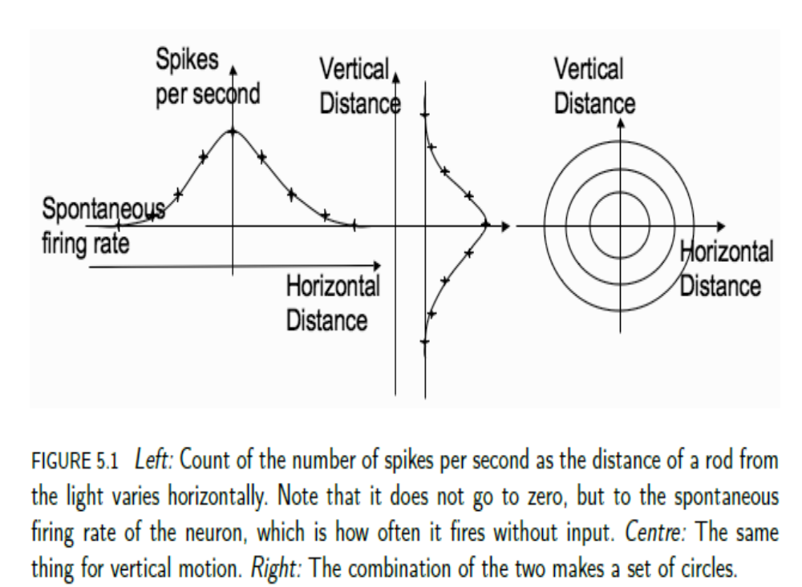

Slide 3
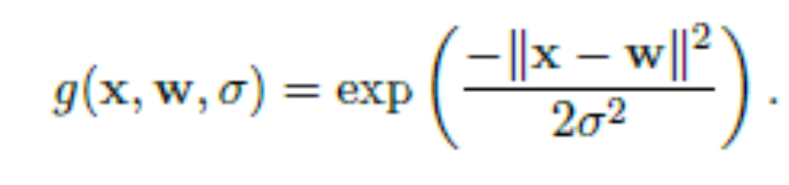

Gaussian, doesn’t really go to 0, but if we truncate it a little, then the output value becomes 0 fairly quickly as we move away from the centre.
The choice of in this equation is quite important, since it controls the width of the Gaussian.
If we make it infinitely large, then the neuron responds to every input.
Suppose instead that we make smaller and smaller, so that the Gaussian gets thinner and thinner.
This means that the receptive field gets narrower and narrower.
This neuron will respond to exactly one stimulus

Slide 4
This function is sometimes known as an indicator or delta function.
Picking the value of for each individual node needs to be part of the algorithm.
So, we can use Gaussians to model these receptive fields for neurons so that nodes will fire strongly if the input is close to them, less strongly if the input is further away, and not at all if it is even further away.
Figure 5.2 shows a set of nodes that represent radial bases in weight space. They are often known as centres because they each form the centre of their own circle or ellipse.
the RBF network is a universal approximator

Slide 5
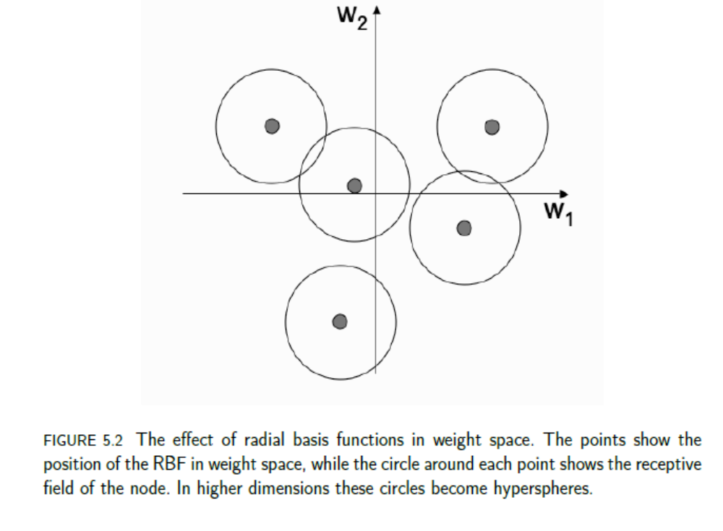

Slide 6
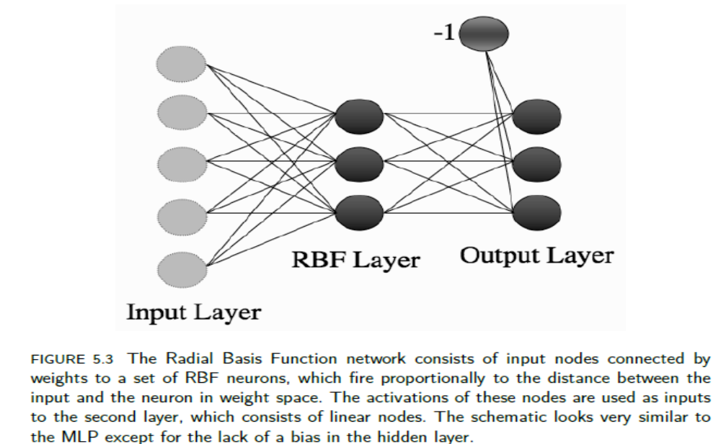
THE RADIAL BASIS FUNCTION (RBF) NETWORK

Slide 7
Comparison of RBF with MLP
RBF networks never have more than one layer of non-linear neurons, in contrast to the MLP.
However, there are many similarities between the two networks: they are both supervised learning algorithms that form universal approximators.
The most important difference between them is the fact that the MLP uses the hidden nodes to separate the space using hyperplanes, which are global, while the RBF uses them to match functions locally.

Slide 8
Training the RBF Network
In the MLP we used back-propagation of error to adjust first the output layer weights, and then the hidden layer weights.
We can do exactly the same thing with the RBF network, by differentiating the relevant activation functions.
However, there are simpler and better alternatives for RBF networks.
They do not need to compute gradients for the hidden nodes and so they are significantly faster.

Slide 9
The important thing to notice is that the two types of node provide different functions, and so they do not need to be trained together.
The purpose of the RBF nodes in the hidden layer is to find a non-linear representation of the inputs,
while the purpose of the output layer is to find a linear combination of those hidden nodes that does the classification.
So we can split the training into two parts: position the RBF nodes, and then use the activations of those nodes to train the linear outputs.
This makes things much simpler.
For the linear outputs we can use an algorithm that we already know: Perceptron

Slide 10
we need to work out something different for the first layer weights, which control the positions of the RBF nodes.
One thing that we can do is to avoid the problem of training completely by randomly picking some of the data points to act as basis locations.
Provided that our training data are representative of the full dataset, this often turns out to be a good solution.
The other thing that we can do is to try to position the nodes so that they are representative of typical inputs.
This is precisely the problem solved by several unsupervised learning methods.
For the RBF network, the most common one is the k-means algorithm

Slide 11
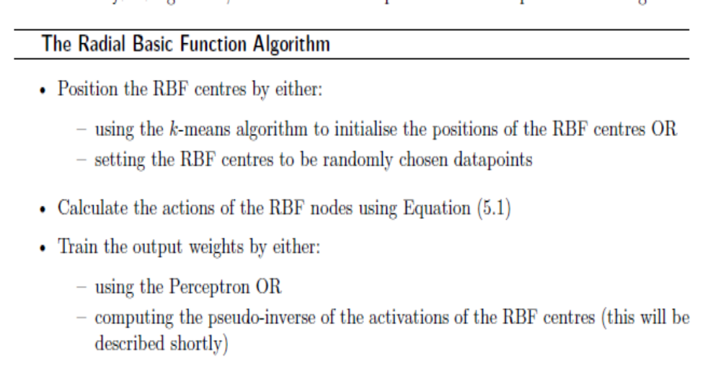
Thus, training an RBF network can be reduced to using two other algorithms that are commonly used in machine learning, one after the other.
This is known as a hybrid algorithm, since it combines supervised and unsupervised learning.

Slide 12
Each input vector, we compute the activation of all the hidden nodes, and assemble them into a matrix G.
So each element of G, say Gij , consists of the activation of hidden node j for input i.
The outputs of the network can then be computed as y = GW for set of weights W.
Except that we don’t know what the weights are—that is what we set out to compute—and we want to choose them using the target outputs t.
If we were able to get all of the outputs correct, then we could write t = GW.
Now we just need to calculate the matrix inverse of G, to get W= G⁻¹−1t.
Unfortunately, there is a little problem here.

Slide 13
The matrix inverse is only defined if a matrix is square, and this one probably isn’t—there is no reason why the number of hidden nodes should be the same as the number of training inputs. In fact, we hope it isn’t, since that would probably be serious overfitting.
Fortunately, there is a well-defined pseudo-inverse G+ of a matrix, which is G+ = (G^{T}G)⁻¹G^{T}
Since the point of the inverse G−1 to a matrix G is that G⁻¹G = I, where I is the identity matrix, the pseudo-inverse is the matrix that satisfies G⁺G = I.
If G is a square, non-singular (i.e., with non-zero determinant) matrix then G⁻¹ = G⁺.
This gives us an alternative to the Perceptron network that is even faster, since the training only needs one iteration:

Slide 14
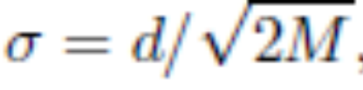
There is one thing that we haven’t considered yet, and that is the size of the receptive fields for the nodes.
We can avoid the problem by giving all of the nodes the same size, and testing lots of different sizes using a validation set to select one that works.
Alternatively, we can select it in advance by arguing that the important thing is that the whole space is covered by the receptive fields of the entire set of basis functions, and so the width of the Gaussians should be set according to the maximum distance between the locations of the hidden nodes (d) and the number of hidden nodes.
The most common choice is to pick the width of the Gaussian as where M is the number of RBFs.

Slide 15
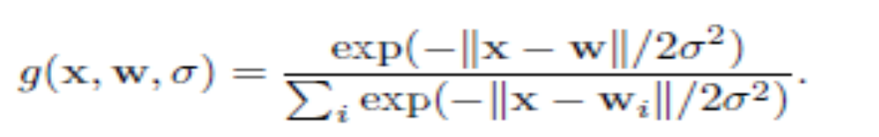
There is another way to deal with the fact that there may be inputs that are outside the receptive fields of all nodes, and that is to use normalised Gaussians, so that there is always at least one input firing: the node that is closest to the current input, even if that is a long way off.
It looks like the soft-max function:
Using the RBF network on the iris dataset that was used with five RBF centres gives similar results to the MLP, with well over 90% classification accuracy.

Slide 16
INTERPOLATION AND BASIS FUNCTIONS
Function approximation: given some data, find a function that goes through the data without overfitting to the noise, so that values between the known data points can be inferred or interpolated.
The RBF network solves this problem by each of the basis functions making a contribution to the output whenever the input is within its receptive field.
So several RBF nodes will probably respond for each input.

Slide 17
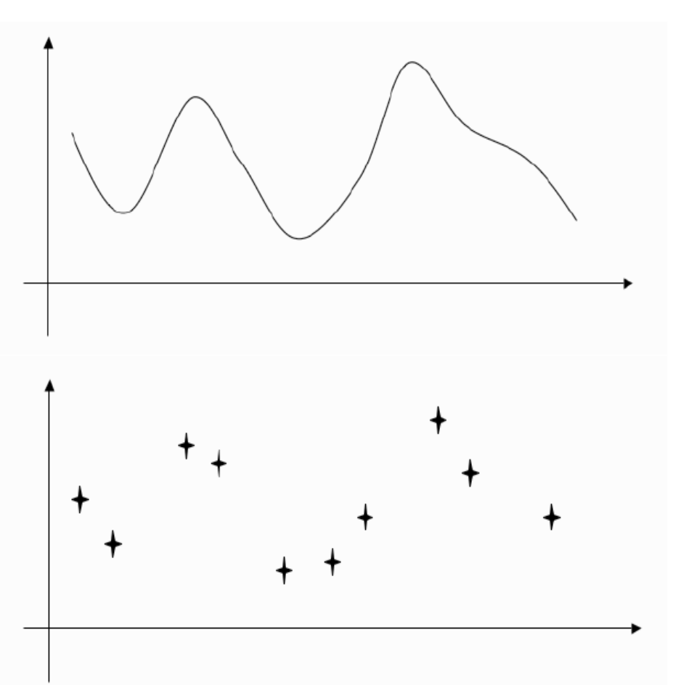
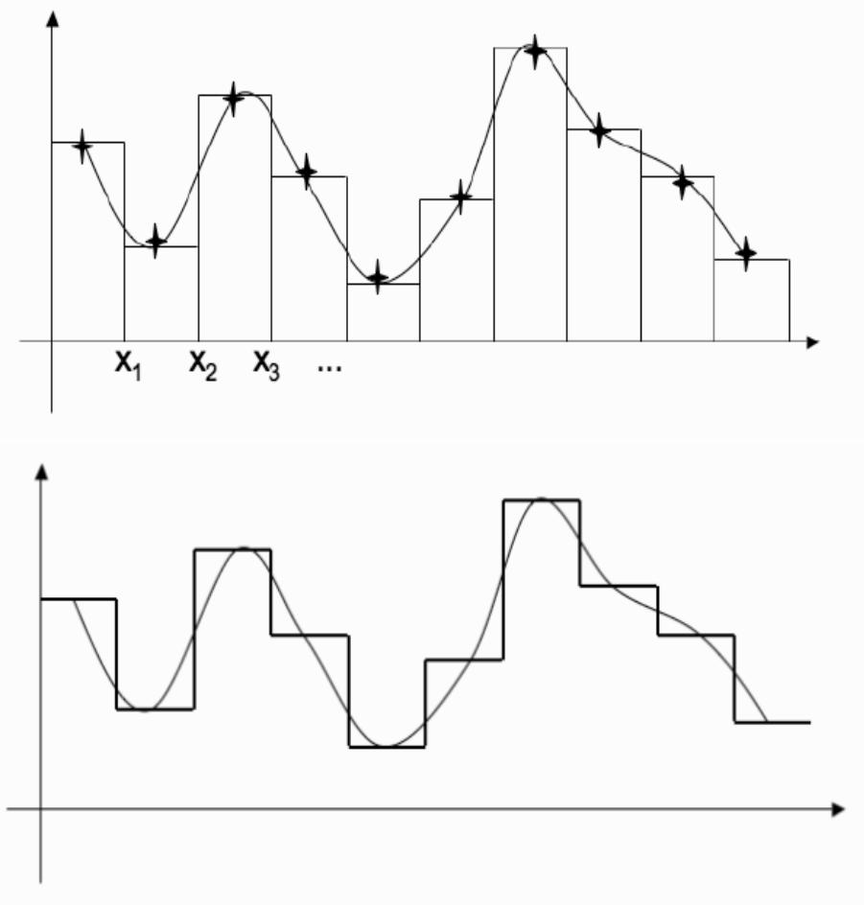
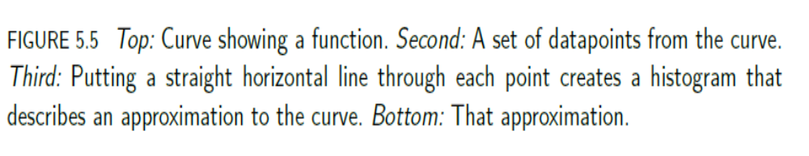

Slide 18
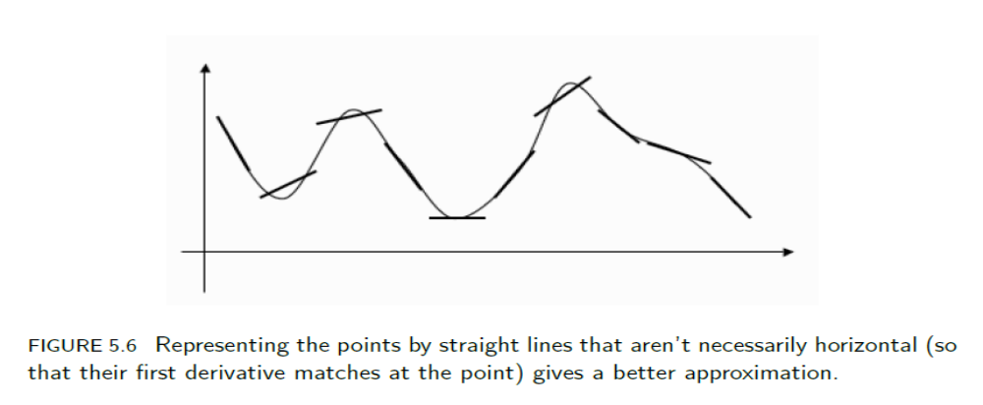
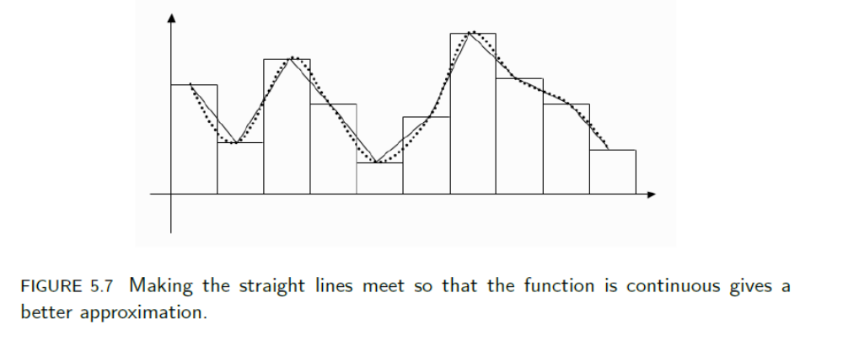

Slide 19
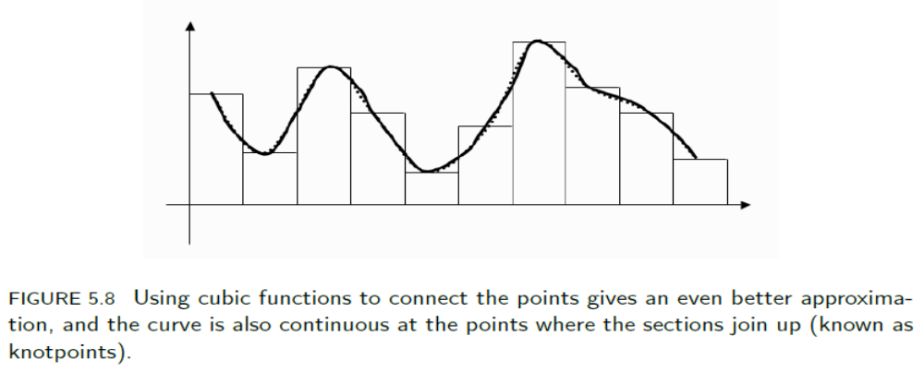

Slide 20
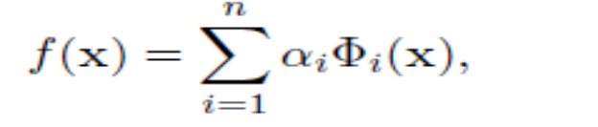



Bases and Basis Expansion
Radial basis functions and several other machine learning algorithms can be written in this form:
where is some function of the input value x and the are the parameters we can solve for in order to make the model fit the data.
We will consider the input being scalar values x rather than vector values x in what follows.
The are known as basis functions and they are parameters of the model that are chosen.
The first thing we need to think about is where each is defined.

Slide 21


Looking at the third graph of Figure 5.5 we see that the
first function should only be defined between 0 and x1, the next between x1 and x2, and so on.
These points xi are called knotpoints and they are generally evenly spaced, but choosing how many of them there should be is not necessarily easy.
The more knotpoints there are, the more complex the model can be, in which case the model is more likely to overfit, and needs more training data, just like the neural networks that we have seen.
We can choose the φ i in any way we like. Suppose that we simply use a constant function φ (x) = 1.
Now the model would have value to the left of x1, value between x1 and x2, etc.

Slide 22
So depending upon how we fit the spline model to the data, the model will have different values, but it will certainly be constant in each region.
This is sufficient to make the straight line approximation shown at the bottom of Figure 5.5.
However, we might decide that a constant value is not enough, and we use a function that varies linearly (a linear function that has value f(x) = x within the region).
In this case, we can make Figure 5.6, where each point is represented by a straight line that is not necessarily horizontal.
This represents the line close to each point fairly well, but looks messy because the line segments do not meet up.

Slide 23
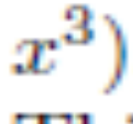
The Cubic Spline
We can carry on adding extra powers of x, but it turns out that the cubic spline is generally sufficient.
This has four basic basis functions
This function constrains the function itself and also its first two derivatives to meet at each knotpoint.
Notice that while the Φs are not linear, we are simply adding up a weighted sum of them, and so the model is linear in them. We can then produce curves like Figure 5.8, which represent the data very well.

Slide 24
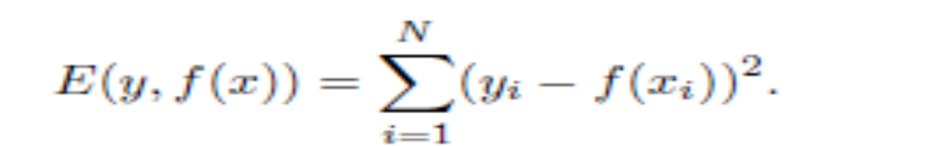
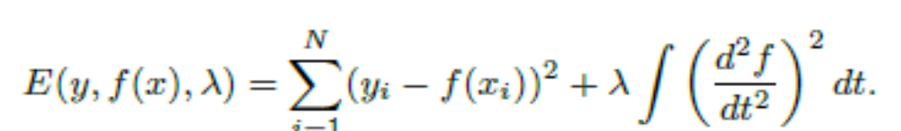
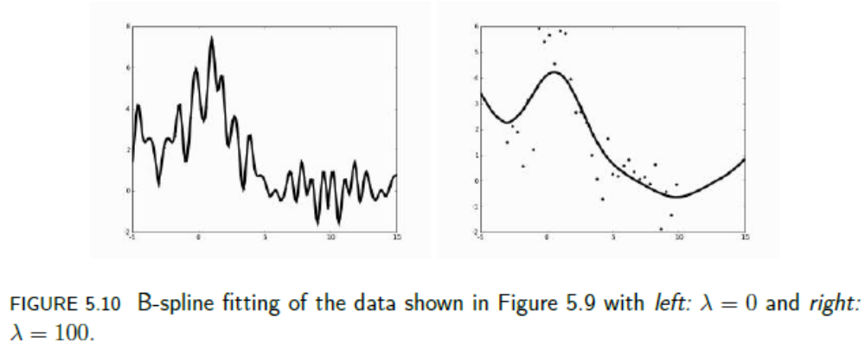
Fitting the Spline to the Data
least-squares fitting
Smoothing Splines

Slide 25
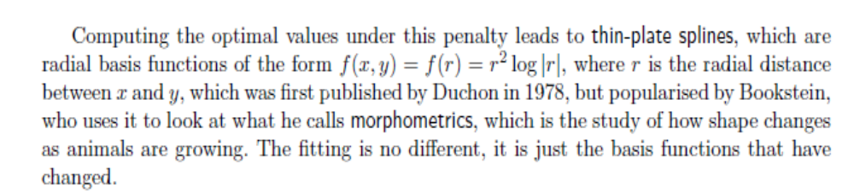
Higher Dimensions
thin-plate splines,
Beyond the Bounds- For the polynomials that we are using here, this turns out to be a serious problem, which means that guesses outside the boundaries (extrapolations) often turn out to be very inaccurate.
Since we don’t have any data, it is hard to do much, but one thing that is sometimes done is to insist that outside the boundary knotpoints the function is linear. This is known as the natural spline.

Slide 26
Linear interpolation is a method of curve fitting using linear polynomials to
construct new data points within the range of a discrete set of known data points.
Formula of Linear Interpolation
y=y1+(x−x1)(y2−y1) / (x2−x1)
Where,
x1 and y1 are the first coordinates
x2 and y2 are the second coordinates
x is the point to perform the interpolation
y is the interpolated value.
Solved Examples
Question: Find the value of y at x = 4 given some set of values (2, 4), (6, 7)?
Solution:
Given the known values are,
x = 4 ; x1 = 2 ; x2 = 6 ; y1=4, y2=7
The interpolation formula is,
y =y1+ (x-x1) (y2-y1) /(x2-x1)
y = 4 + (4-2) (7-4) / (6-2)
y = 4 + 2.3/4
y = 11/2

